Slide 1
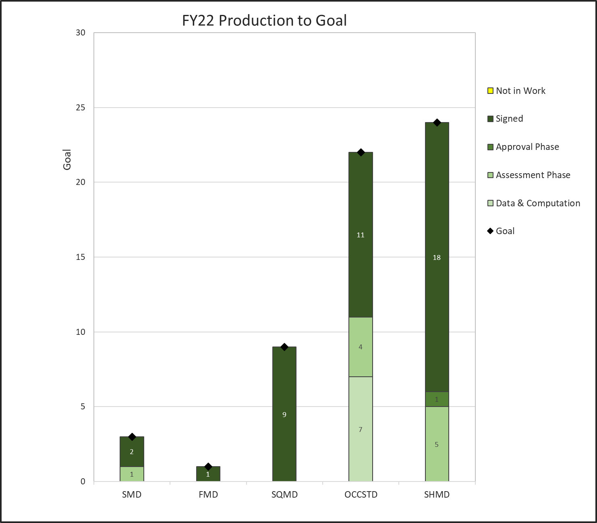
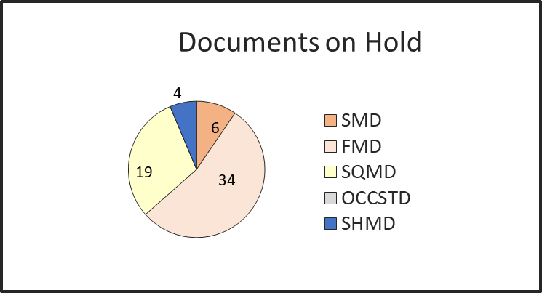
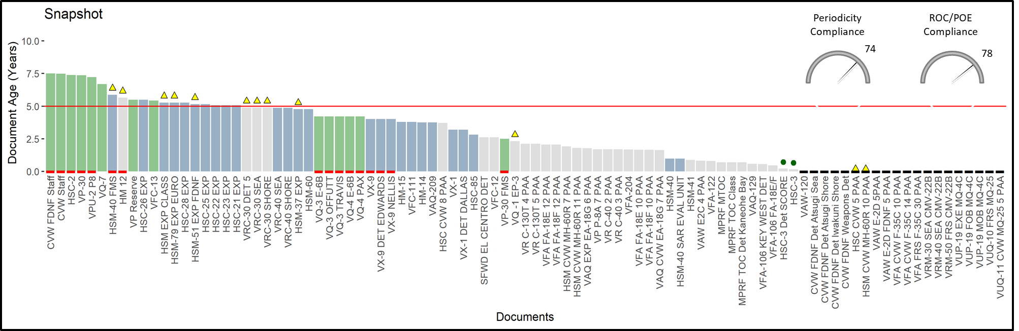
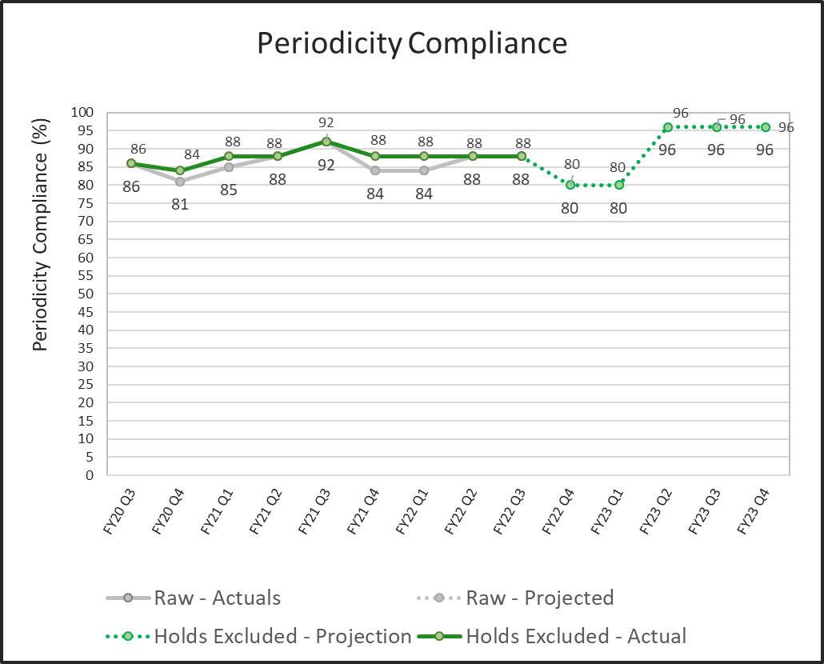
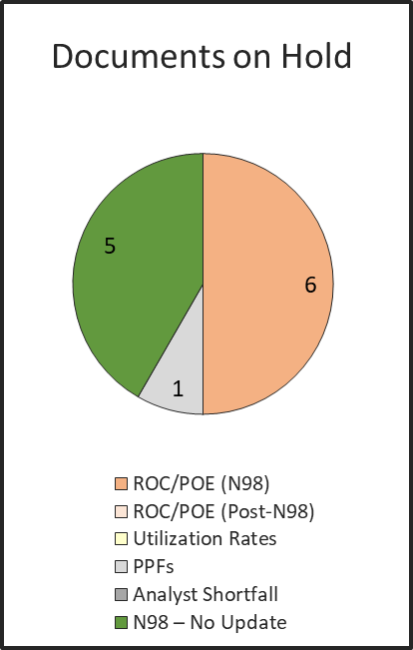
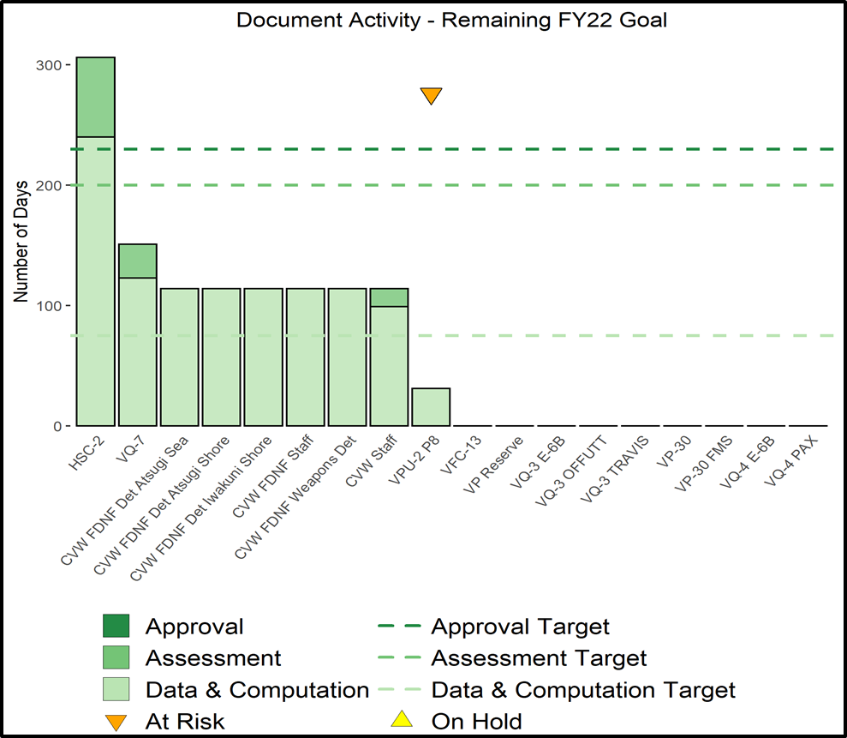
Code 50
23 Apr 2024

Slide 2
Code 50 Establishment
Provide analytics, modeling, and process improvement support for command production metrics, decision support, manpower requirements determination, occupational classification, automation, and special manpower studies.
Manage multiple data sources, data structures, algorithms, and models and provide visualization for decision makers to evaluate effectiveness & efficiency of Navy Manpower Programs.
Implement efficient data handling and computational procedures across the various stages of manpower requirement document production.
Established in FY20 to harness skill sets of GS-13/14 civilians and NPS-trained officers

Slide 3
Org Chart & Mission Areas
Design & Analysis
Data Science
Metrics
DIRECTOR
GS-14 Sup. OR Analyst
DEPUTY
HR O-5 Milestone
TECH LEAD
Senior OR Analyst
TEAM LEAD
O-3 Ops Research Analyst
TEAM LEAD
GS-13 Industrial Engineer
TEAM LEAD
O-3 Ops Research Analyst
GS-13 Ops Research Analyst
GS-13 Industrial Engineer
GS-13 Ops Research Analyst
GS-13 Ops Research Analyst
GS-13 Industrial Engineer
GS-13 Ops Research Analyst
GS-13 Ops Research Analyst
DATA SCIENCE
DESIGN & ANALYSIS
METRICS
Data Engineering
Modeling
Optimization
Automation
“Big Data”
Standardization/Integration
Continuous Process Improvement
System Design/Analysis
Consulting/Training
Knowledge Management
Productivity/KPI Tracking
Automated Data Collection
Dashboards/Visualization Tools
Predictive Analytics
Risk Assessment
Code 50 mission is to provide tools and strategic insights needed for data-driven decisions about limited resources & priorities to achieve mission

Slide 4
Significant Initiatives
Code 50
Provides analytics for command production
Analytics and modeling support
Visualization for decision makers
Implement efficient data handling
Consulting
Fleet Manpower Requirements Determination (FMRD) Model
  Facilitates bi-weekly drumbeat with stakeholders for ongoing review of the optimization approach and mixed integer linear programming formulation
  Bridges the gap with contracted IT support staff to explain why and how the model can be modified to better meet the need
  Helps with change management and translates analytic methodologies/techniques and outcomes to manpower functional personnel performing the work
Innovation
  Using operations research techniques to modernize systems, create analytic tools, and automate processes to reduce manual work and save valuable time of manpower analysts
Metrics Transformation/Performance to Plan (P2P)
  Produces “metrics that matter” aligned to strategic objectives to focus leaders on right challenges
  Applies high level of discipline regarding how metrics are defined and reported with organization-wide clarity on actuals, plans, and goals
  Utilizes predictive analytics to understands cause-and-effect relationships
  Champions a culture of transparency, commitment, learning, and accountability
System Design and Process Improvement
  Integrating tools and technology to improve efficiency with focus on standardization of processes
  Championing a Continuous Process Improvement (CPI) culture
Creating & Automating
Tracking & Predicting
Improving
Code 50 Vision is to enable sustained high performance through initiatives

Slide 5
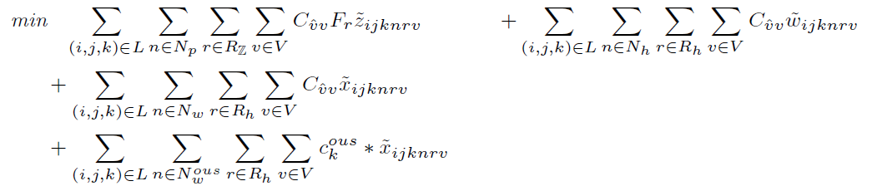
Fleet Manpower Requirements Determination (FMRD)
Purpose of FMRD
  Update and modernize legacy Navy Manpower Resource System (NMRS)
  Apply linear optimization to manpower planning
  Use as a potential paradigm for Shore Manpower
Code 50 Role
  Facilitate meetings with BAH optimization team (every 2-3 weeks)
  Advocate for Codes 30, Code 40, and Fleet (e.g., Fleet business rules, global metrics)
  Provide project management consultation (e.g., backlog prioritization)
  Identify issues in the “engine” before they happen
  Advise modelers on model formulation and implementation
  Act as the glue between business systems and model architecture
  Remove barriers to full model implementation
  Provide risk mitigation strategies for leadership
Notes:
Ref:
https://en.wikipedia.org/wiki/Deterministic_global_optimization
https://en.wikipedia.org/wiki/Stochastic_optimization

Slide 6
NAVMAC P2P
“Metrics Transformation” Approved by N12 on 18 Dec 2019
Completed WG led by CDR Tim Shaffer in 2019
Tasked P2P process and dashboards to implement program
  Measure document compliance against periodicity expectations
  Track document production against approved time standards
Set guiding principles
  Focus leadership attention on a set of “metrics that matter” that align to strategic objectives
  Establish a high level of discipline regarding how metrics are defined and reported with organization-wide clarity on actuals, plans, and goals
  Develop predictive analytics to understands cause-and-effect relationships, and then take action
  Create a culture of transparency, commitment, learning, and accountability
Standardized terminology/phases (reflected in NAVMACINST 5310.18 series)
1
Preliminary
2
Data
3
Computation/QA
4
Assessment
5
Approval
6
Implementation
3A
Data Analysis
3B
Draft Dev.
Focused on standardizing metrics and measuring performance

Slide 7
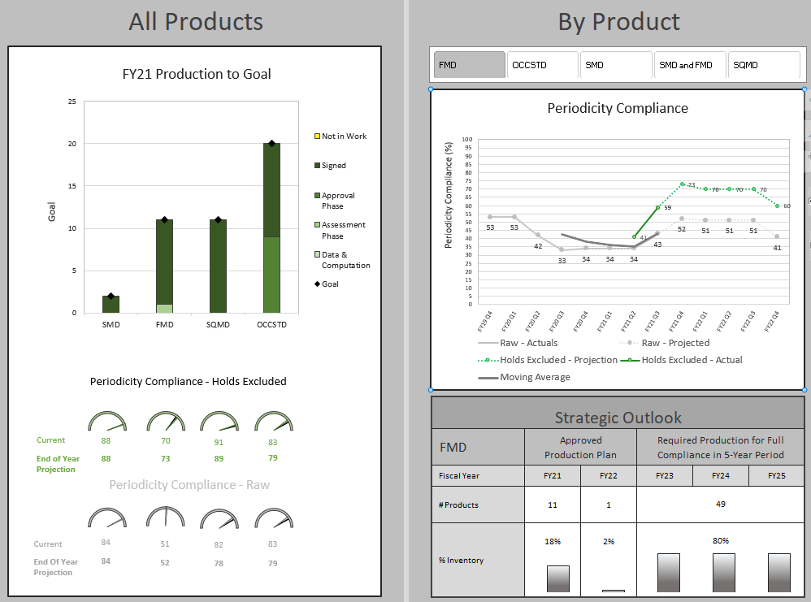
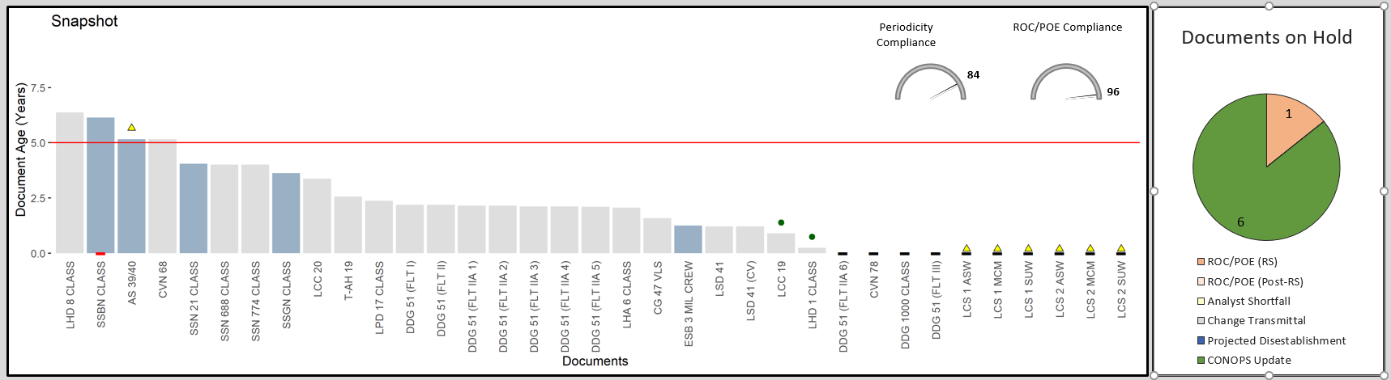
P2P Structure
RED = predictive
Tier 1 – Executive Overview
  KPI: Periodicity Compliance
  Production vs. Goal Comparison
  Strategic Outlook
  Schedule Longitudinal View
  Documents on Hold
Tier 2 – Production Line Detail
  KPI: ROC/POE Compliance
  Snapshot of Age vs. Periodicity
  Work in Progress incl. Time in Work
  Goal-at-Risk Indicators
Tier 3 – Data Tables
  All-in-One Summary
  Documents on Hold
  Data Input Reference
8 of 30 product lines (external customer facing) are visualized in P2P

Slide 8
Data Collection Instruments
Standardized Reporting of External Product Lines
There is no (nor will there be a) corporate IT system for tracking our products. NAVMAC P2P is a permanent solution.
P01
OCCSTD
P2P
NEOCS
P02
NOOCS
P04
SQMD
P05
MRW
MRW
P06
STFSTD
STFSTD
P07
FLEET PRODSTAT 2.0
SMD
P08
FMD
P09
SMRD
Spreadsheet
Database
Built using advanced Excel/VBA, Access, and R programming

Slide 9
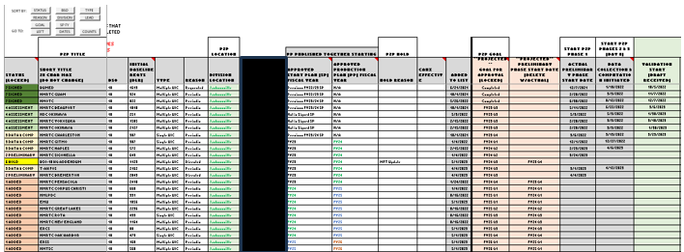
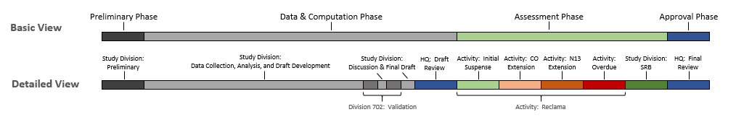
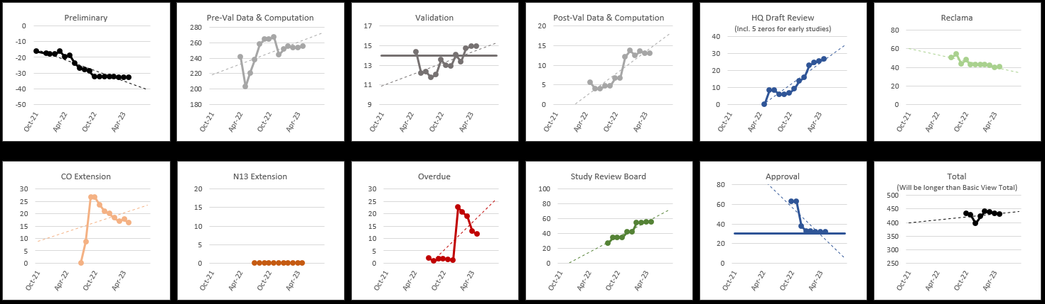
Trackers & Analysis Tools
Helping leaders identify focus areas for improvement

Slide 10
TFMRD Production Plan
  Codes 30/40/70 provide inputs based on BSO/TYCOM collaboration
  Code 50 reconciles these inputs during P2P and Shore SPR data calls
  P2P is the authoritative source (P2P) to ensure accuracy
InstaPlan
    Shore InstaPlan tool was delivered Aug 2023
    Fleet InstaPlan was delivered Sep 2023
    Enables distribution to stakeholders at any desired periodicity
Code 50 works with codes to adjust goals continuously (not just annually)

Slide 11
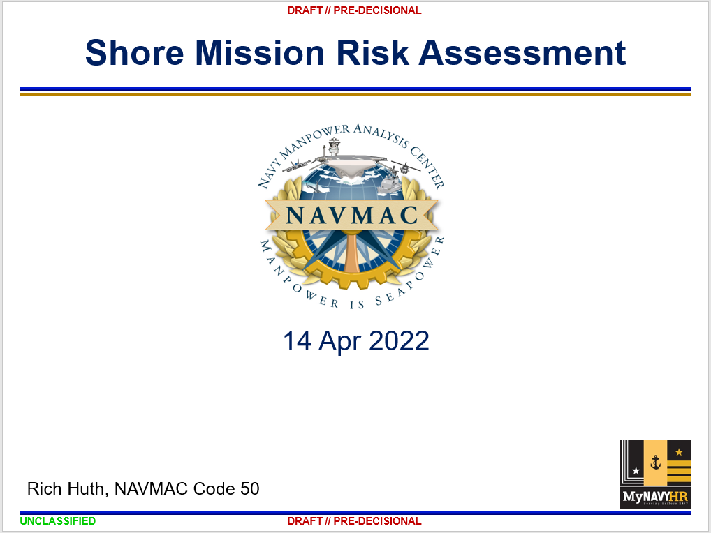
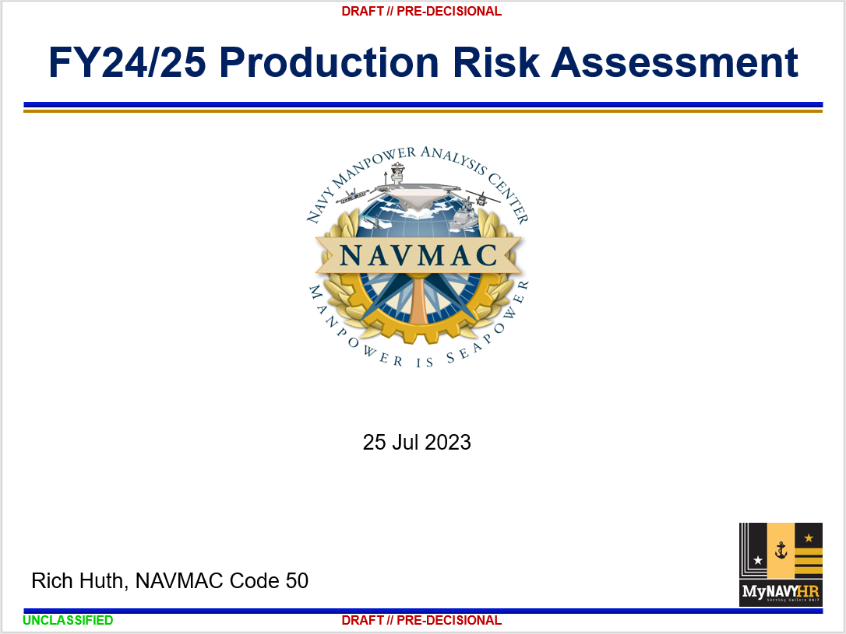
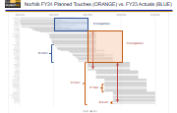
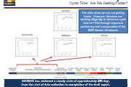
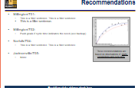
Risk Assessment for NAVMAC Products
Help identify barriers and best mitigate

Slide 12
Data Science Brown Bag
Contact Code 50 to:
  Join the NAVMAC Data Science Brown Bag MS Teams channel
  Get access to the materials used by the presenters
  Receive a calendar invite for the monthly presentation
Passionate about building synergy and analytic capabilities across the command

